Slide 1
GRADE 7 ACCELERATED · UNIT 2 · LESSON 4
Approximating Irrational Numbers
MA.8.NSO.1.1
I can tell a rational number from an irrational one, and approximate a root to the nearest tenth.
Lesson 1 asked what the side of an area-8 square was.
Today it gets a name and a value.
Grade 7 Accelerated · Unit 2 · Lesson 4 — Approximating Irrational Numbers
1

Slide 2
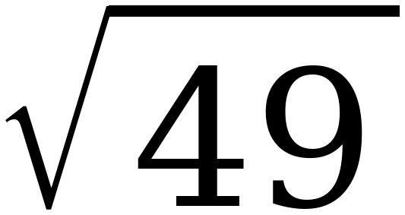
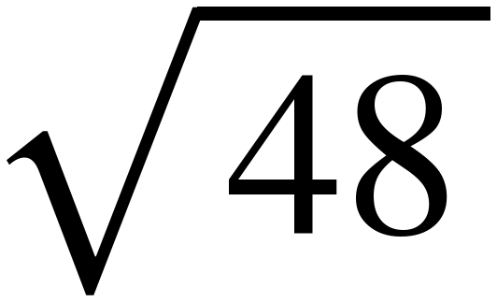
Warm-Up
On your own. Four minutes.
Same and different
What is the same about these two, and what is different?
Grade 7 Accelerated · Unit 2 · Lesson 4 — Approximating Irrational Numbers
2

Slide 3
Notes
I. A rational number's decimal stops or repeats
A.
rational number — a number that can be written as a ratio of two integers
B.
As a decimal it either STOPS or REPEATS.
C.
0.375, −8, 13/3, 0.666… are all rational.
Grade 7 Accelerated · Unit 2 · Lesson 4 — Approximating Irrational Numbers
3

Slide 4
Notes
II. An irrational number's decimal does neither
A.
irrational number — not a ratio of two integers
B.
Its decimal never stops and never repeats.
C.
π is irrational. 3.14 and 22/7 are approximations — neither of them IS π.
Grade 7 Accelerated · Unit 2 · Lesson 4 — Approximating Irrational Numbers
4

Slide 5
Notes
III. The radicand decides, not the radical sign
The root
Rational or irrational?
Why
√25 = 5
rational
25 is a perfect square
√18
irrational
18 is not a perfect square
∛27 = 3
rational
27 is a perfect cube
∛30
irrational
30 is not a perfect cube
Grade 7 Accelerated · Unit 2 · Lesson 4 — Approximating Irrational Numbers
5

Slide 6
Notes
IV. Approximating to the nearest tenth — four steps
A.
Find the two perfect squares (or cubes) the radicand sits between.
B.
That gives the two consecutive integers the root sits between.
C.
Compare the two distances to decide which of the two it is nearer.
D.
Test tenths. Square (or cube) them and see which lands closest.
Grade 7 Accelerated · Unit 2 · Lesson 4 — Approximating Irrational Numbers
6

Slide 7
Example 1
√13. Steps 1 and 2, out loud.
A.
Step 1: 9 < 13 < 16
B.
Step 2: 3 < √13 < 4
Which of the two integers is it nearer, and how do you know?
Grade 7 Accelerated · Unit 2 · Lesson 4 — Approximating Irrational Numbers
7

Slide 8
Example 1
Step 3, then test tenths.
A.
Step 3: 13 − 9 = 4 and 16 − 13 = 3, so it is nearer 4.
B.
Step 4: 3.6 × 3.6 = 12.96 3.7 × 3.7 = 13.69
C.
12.96 misses by 0.04. 13.69 misses by 0.69.
Grade 7 Accelerated · Unit 2 · Lesson 4 — Approximating Irrational Numbers
8

Slide 9
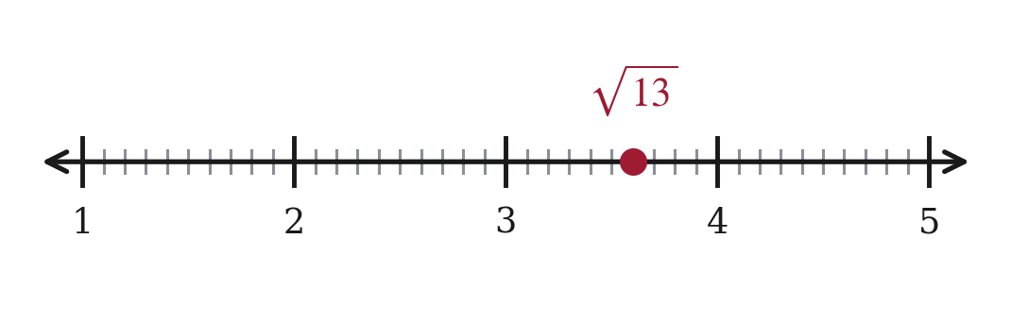
Example 1
√13 ≈ 3.6.
Grade 7 Accelerated · Unit 2 · Lesson 4 — Approximating Irrational Numbers
9

Slide 10
Example 2
∛20. Same four steps. What changes?
Nothing on paper yet. Say which list you will use, and why.
Grade 7 Accelerated · Unit 2 · Lesson 4 — Approximating Irrational Numbers
10

Slide 11
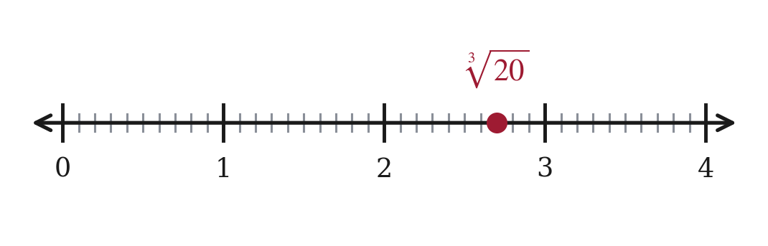
Example 2
∛20 ≈ 2.7.
A.
Step 1: 8 < 20 < 27 two perfect CUBES
B.
Step 2: 2 < ∛20 < 3
C.
Step 3: 20 − 8 = 12 and 27 − 20 = 7, so it is nearer 3.
D.
Step 4: 2.7³ = 19.683 2.8³ = 21.952
Grade 7 Accelerated · Unit 2 · Lesson 4 — Approximating Irrational Numbers
11

Slide 12
Example 3
Priya and her calculator disagree.
Priya rounds first
The calculator does not
√6 ≈ 2.4
√6 = 2.449489…
2 × 2.4 = 4.8
2 × 2.449489… = 4.898979…
One of them is wrong. Which, and why?
Grade 7 Accelerated · Unit 2 · Lesson 4 — Approximating Irrational Numbers
12

Slide 13
Example 3
Priya is.
2√6 = 4.898979…, which is 4.9 to the nearest tenth.
A.
Rounding 2.449 down to 2.4 throws away 0.049.
B.
Doubling throws away 0.098 — almost a whole tenth, which is the whole answer.
Grade 7 Accelerated · Unit 2 · Lesson 4 — Approximating Irrational Numbers
13

Slide 14
Example 3
So: round last.
Using 2.45 instead: 2 × 2.45 = 4.90 ✓
Grade 7 Accelerated · Unit 2 · Lesson 4 — Approximating Irrational Numbers
14

Slide 15
Whiteboards · Question 1 of 9
Boards up on three.
Rational or irrational? Give its value.
If it is irrational, the nearest tenth is enough.
Grade 7 Accelerated · Unit 2 · Lesson 4 — Approximating Irrational Numbers
15

Slide 16
Whiteboards · Question 1 of 9
Answer.
49 is a perfect square
Answer: rational, 7
Grade 7 Accelerated · Unit 2 · Lesson 4 — Approximating Irrational Numbers
16

Slide 17
Whiteboards · Question 2 of 9
Boards up on three.
Rational or irrational? Give its value.
If it is irrational, the nearest tenth is enough.
Grade 7 Accelerated · Unit 2 · Lesson 4 — Approximating Irrational Numbers
17

Slide 18
Whiteboards · Question 2 of 9
Answer.
36 < 48 < 49, so it is just under 7
Answer: irrational, ≈ 6.9
Grade 7 Accelerated · Unit 2 · Lesson 4 — Approximating Irrational Numbers
18

Slide 19
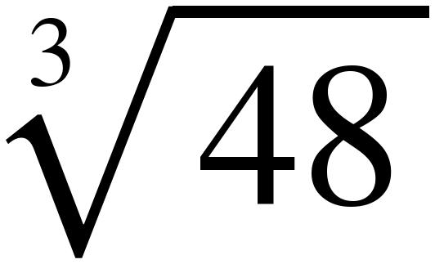
Whiteboards · Question 3 of 9
Boards up on three.
Rational or irrational? Give its value.
If it is irrational, the nearest tenth is enough.
Grade 7 Accelerated · Unit 2 · Lesson 4 — Approximating Irrational Numbers
19

Slide 20
Whiteboards · Question 3 of 9
Answer.
27 < 48 < 64, so it is between 3 and 4
Answer: irrational, ≈ 3.6
Grade 7 Accelerated · Unit 2 · Lesson 4 — Approximating Irrational Numbers
20

Slide 21
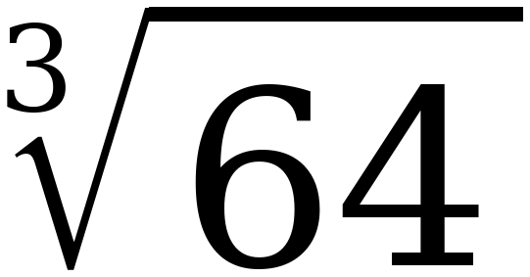
Whiteboards · Question 4 of 9
Boards up on three.
Rational or irrational? Give its value.
If it is irrational, the nearest tenth is enough.
Grade 7 Accelerated · Unit 2 · Lesson 4 — Approximating Irrational Numbers
21

Slide 22
Whiteboards · Question 4 of 9
Answer.
64 is a perfect cube
Answer: rational, 4
Grade 7 Accelerated · Unit 2 · Lesson 4 — Approximating Irrational Numbers
22

Slide 23
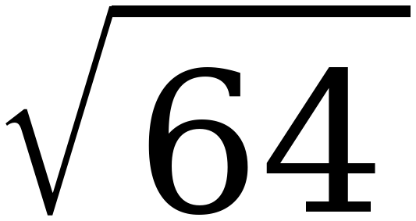
Whiteboards · Question 5 of 9
Boards up on three.
Rational or irrational? Give its value.
If it is irrational, the nearest tenth is enough.
Grade 7 Accelerated · Unit 2 · Lesson 4 — Approximating Irrational Numbers
23

Slide 24
Whiteboards · Question 5 of 9
Answer.
64 is a perfect square TOO
Answer: rational, 8
Grade 7 Accelerated · Unit 2 · Lesson 4 — Approximating Irrational Numbers
24

Slide 25
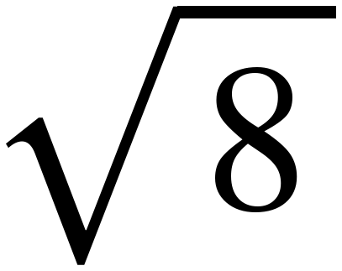
Whiteboards · Question 6 of 9
Boards up on three.
Rational or irrational? Give its value.
If it is irrational, the nearest tenth is enough.
Grade 7 Accelerated · Unit 2 · Lesson 4 — Approximating Irrational Numbers
25

Slide 26
Whiteboards · Question 6 of 9
Answer.
4 < 8 < 9, so it is just under 3
Answer: irrational, ≈ 2.8
Grade 7 Accelerated · Unit 2 · Lesson 4 — Approximating Irrational Numbers
26

Slide 27
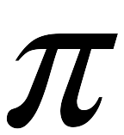
Whiteboards · Question 7 of 9
Boards up on three.
Rational or irrational? Give its value.
If it is irrational, the nearest tenth is enough.
Grade 7 Accelerated · Unit 2 · Lesson 4 — Approximating Irrational Numbers
27

Slide 28
Whiteboards · Question 7 of 9
Answer.
3.14159265… — it never repeats and never stops
Answer: irrational, ≈ 3.14
Grade 7 Accelerated · Unit 2 · Lesson 4 — Approximating Irrational Numbers
28

Slide 29
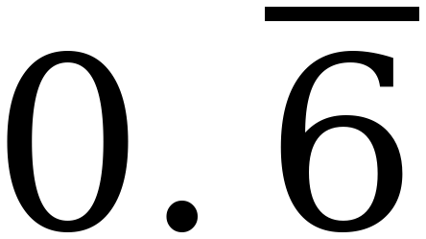
Whiteboards · Question 8 of 9
Boards up on three.
Rational or irrational? Give its value.
If it is irrational, the nearest tenth is enough.
Grade 7 Accelerated · Unit 2 · Lesson 4 — Approximating Irrational Numbers
29

Slide 30
Whiteboards · Question 8 of 9
Answer.
0.666… = 2/3, a ratio of two integers
Answer: rational, = 2/3
Grade 7 Accelerated · Unit 2 · Lesson 4 — Approximating Irrational Numbers
30

Slide 31
Whiteboards · Question 9 of 9
Take your time. Boards up when you have written it.
Marcus says any decimal that goes on forever is irrational. Is he right?
Write your answer in sentences.
This one is written work. Give an example that proves your answer.
Grade 7 Accelerated · Unit 2 · Lesson 4 — Approximating Irrational Numbers
31

Slide 32
Whiteboards · Question 9 of 9
Answer.
Marcus says any decimal that goes on forever is irrational. Is he right?
0.666… goes on forever and equals 2/3
Answer: No — it has to go on WITHOUT REPEATING
Grade 7 Accelerated · Unit 2 · Lesson 4 — Approximating Irrational Numbers
32

Slide 33
IXL
Last five minutes.
1.
Open IXL and start today's skills.
2.
Work on paper where the question needs work. The answer box does not show it.
3.
Whatever you do not finish is tonight's practice.
4.
The skills for today are posted in Google Classroom.
Grade 7 Accelerated · Unit 2 · Lesson 4 — Approximating Irrational Numbers
33

